Slide 1
Classification and Analysis of EEG Signals
Endsem Report
Under the supervision of Dr. Anurag Nishad
Aayush Chandak
2018B2A80433G

Slide 2
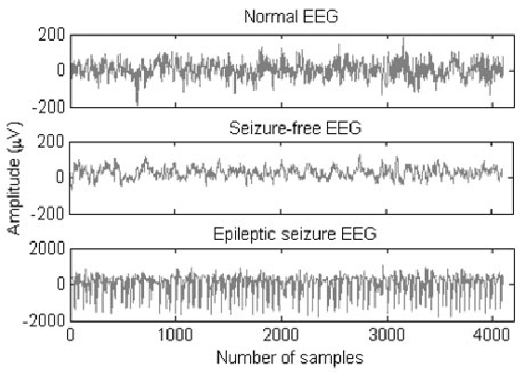
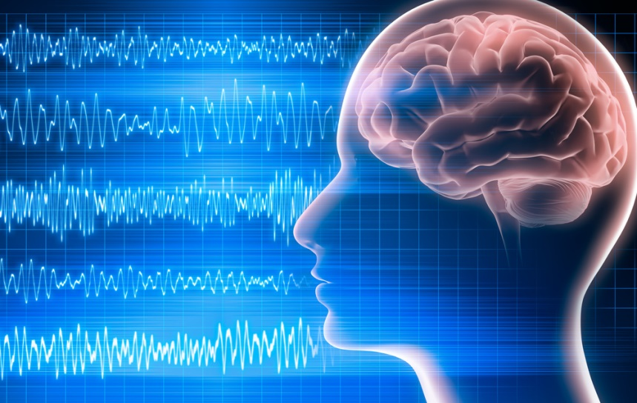
What is EEG?
Clinically, Electroencephalography (EEG) refers to the recording of the brain's spontaneous electrical activity over a period of time, as recorded from multiple electrodes placed on the scalp.
EEG measures voltage fluctuations resulting from ionic current within the neurons of the brain.
The EEG potentials can be Event related potentials (ERPs) or Spontaneous/ free running potentials.
Their applications include distinguishing epileptic seizures, monitoring the depth of anaesthesia, coma and brain deaths, investigating sleep disorders and mental disorders.
EEG Signals
Epileptic Seizures

Slide 3
Advantages
Most inexpensive methods of neuroimaging.
No harmful side effect of this process on human health is reported.
EEG procedure indeed measure electrical voltages which is generated naturally in the brain, it does not inject any electrical signal.

Slide 4
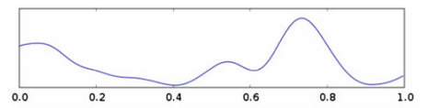
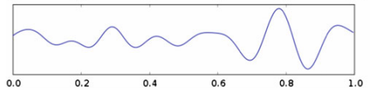
Characteristics and Nature of EEG Signals
1. Delta Wave:
The delta wave lies between the range of 0.5–4 Hz.
2. Theta Wave:
The theta wave lies between 4 and 8 Hz with an amplitude usually greater than 20 µV.

Slide 5
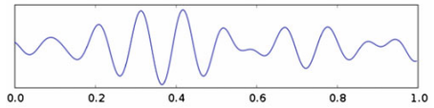
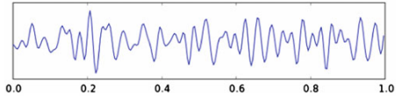
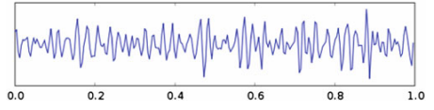
3. Alpha Wave:
The alpha contains the frequency range from 8 to 13 Hz, with 30–50 µV amplitude.
4. Beta Wave:
The beta is in the frequency range of 13–30 Hz.
5. Gamma Wave:
The gamma waves have the frequency from 30 Hz and up.

Slide 6
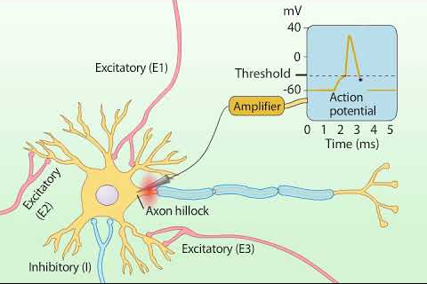
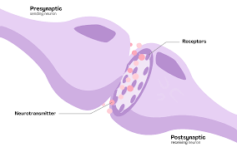
Generation Organism of EEG Signals in Brain
Through the axon–dendrite link, neurons can communicate between each other because of the action potential (AP).
The neurons emit a chemical called neurotransmitters.
The current that flows because of this inter neuron communication contribute to the surface EEG during a net excitatory input.
Inhibitory and excitatory Post Synaptic Potentials create electrical dipoles between the cell body and the dendrites. These PSPs summate in the cortex and extend to the scalp surface where they are recorded as the EEG.
Neuron
Neurotransmitters

Slide 7
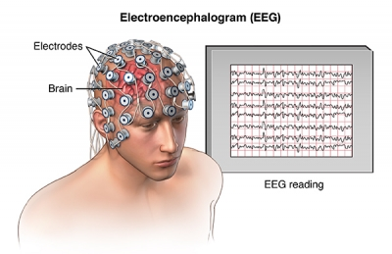
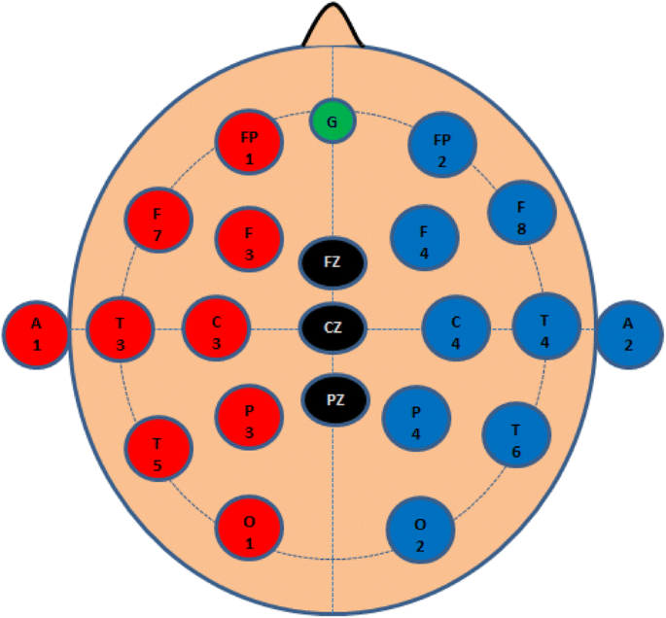
Recording the EEG Signals
During the EEG test a number of small disks called electrodes are placed in different locations on the surface of the scalp with temporary glues.
The standard method for the scalp electrode localization is the international 10–20 electrode system.
Figure below presents the electrode position on the brain. The letters F, T, C, P and O stand for Frontal, Temporal, Central, Parietal and Occipital, respectively. “z” refers to an electrode placed on the midline. Even numbers refer to electrode positions on the right hemisphere, whereas odd numbers refer to those on the left hemisphere.
Position of electrode
Recording setup

Slide 8
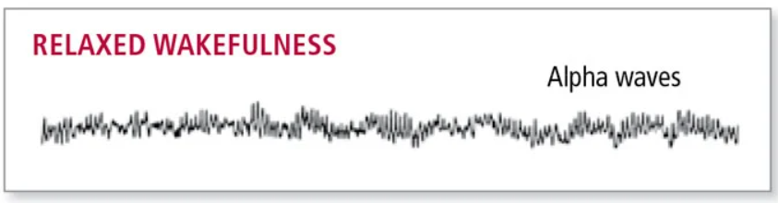
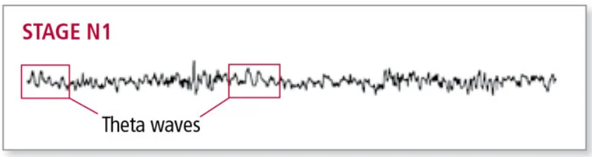
EEG Sleep Signals
Sleep can be divided into two different general phases: Rapid Eye Movement (REM) sleep and Non-REM (NREM) sleep. NREM sleep is subdivided into four stages distinguished from each other by characteristic patterns of brain waves.
Stage Wake (W) - Typically the first several minutes of the record will consist of wake (W) stage. It mostly consists of Alpha waves.
Stage N1 REM (N1) - Transition into sleep occurs following stage W sleep. Stage N1 lasts for 1 to 7 minutes. It mostly consists of Theta waves.

Slide 9
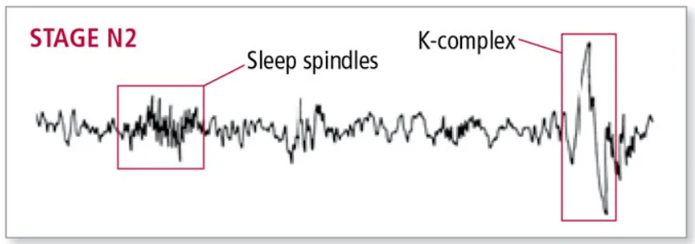
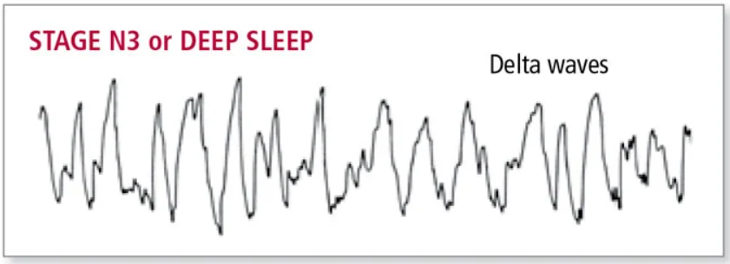
Stage N2 REM (N2) - It follows stage N1 NREM sleep and initially lasts about 20 minutes. It mostly consists of theta activity and sleep spindles and K-complex wave structures are seen.
Stage N3 REM (N3) – It constitutes the deepest, most refreshing and restorative sleep type. This stage is marked by high-amplitude slow waves and delta waves.

Slide 10
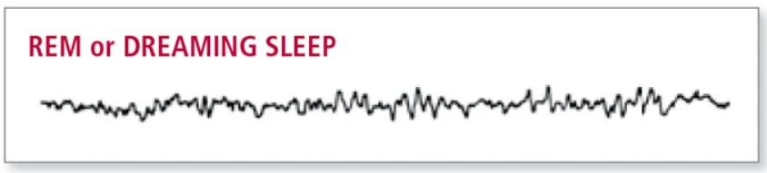
Stage REM Sleep (R) – Typically occurs about 90 to 120 minutes after sleep onset in adults. It typically occupies 20% to 25% of the major period of sleep. It characterized by relatively low-amplitude, mixed-frequency EEG theta waves, intermixed with some alpha waves, usually 1 to 2 Hz slower than wake stage.
The waveforms of various stages of sleep is different because it is formed by frequencies of different values. Hence, the frequency values were used as the parameter to classify the stages of sleep as W, N1, N2, N3 and R in the model. There are 4 sections in the model –
Environment Setup
Loading the Data
Feature Engineering
Multi – class Classification Workflow

Slide 11
Environment Setup
NumPy – For adding support for large, multi-dimensional arrays and matrices, along with a large collection of high-level mathematical functions to operate on these arrays.
Matplotlib – Matplotlib is a cross-platform, data visualization and graphical plotting library for Python and its numerical extension NumPy.
MNE – MNE-Python software is an open-source Python package for exploring, visualizing, and analyzing human neurophysiological data such as MEG, EEG, ECoG, and more.
SKlearn - The SKlearn library contains a lot of efficient tools for machine learning and statistical modeling including classification, regression, clustering and dimensionality reduction.

Slide 12
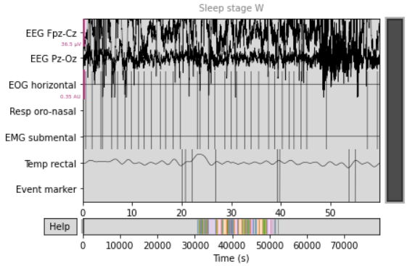
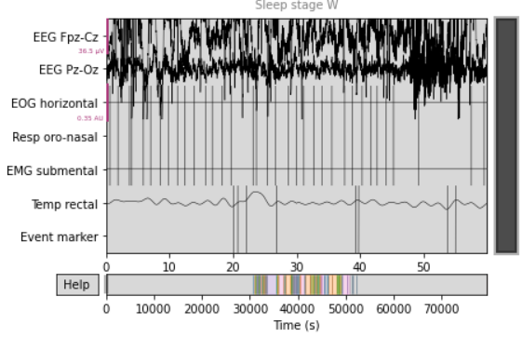
Loading the Data
The dataset was downloaded from Sleep Physionet dataset using the function mne.datasets.sleep_physionet.age.fetch_data. This dataset has recordings of 2 subjects namely Alice and Bob.
Signals other than EEG signals were labeled as ‘miscellaneous’.
Alice’s Data
Bob’s Data

Slide 13
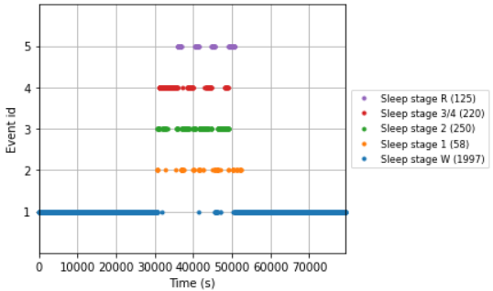
Creating Epoch
Then from this raw data, an event of 30 seconds called as an epoch was created only for the EEG signals.
Initially the dataset had 6 stages of sleep. That was converted to 5 stages of sleep by combining the stages N3 and N4 into a single stage N3.
To do so, the event_id parameter in function mne.events_from_annotations was used.
The total epochs for Alice’s dataset were 2650 and for Bob’s dataset were 2802.
Epochs of Alice’s dataset

Slide 14
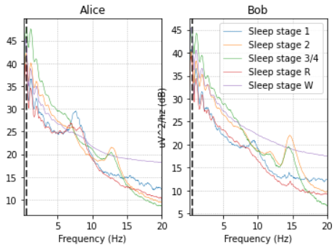
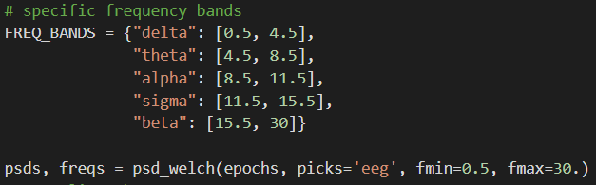
Feature Engineering
Power Spectral Density (PSD) plot of both the datasets was done. Different sleep stages have different signatures. These signatures remain similar between Alice and Bob's data.
A function was created to extract EEG features based on relative power in specific frequency bands to be able to predict sleep stages from EEG signals.
Both the datasets were then merged and 1400 epochs each of Alice’s and Bob’s data were taken for classification.

Slide 15
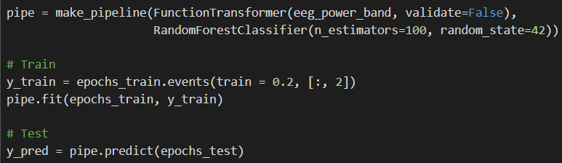
Multi – Class Classification Workflow
Scikit-learn pipeline composes an estimator as a sequence of transforms and a final estimator. “fit” to learn on the data and acquire state and “transform" (or "predict") to actually process the data and generate a prediction.
The FunctionTransformer converts a python function in an estimator compatible object. As the name suggests, it takes an argument and returns the result of the function.
Random forest consists of a large number of individual decision trees that operate as an ensemble. Each individual tree in the random forest spits out a class prediction and the class with the most votes becomes the model’s prediction.

Slide 16
Results
Confusion Matrix – For showing how the epochs were classified.
“true positive” for correctly predicted event values.
“false positive” for incorrectly predicted event values.
“true negative” for correctly predicted no-event values.
“false negative” for incorrectly predicted no-event values.
 | W | N1 | N2 | N3 | R
W | 1853 | 0 | 0 | 1 | 0
N1 | 91 | 3 | 6 | 5 | 5
N2 | 119 | 12 | 385 | 34 | 12
N3 | 0 | 0 | 4 | 101 | 0
R | 89 | 30 | 19 | 0 | 32

Slide 17
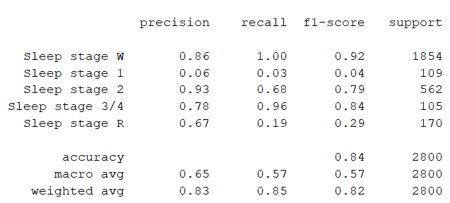
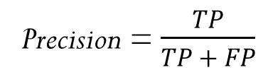
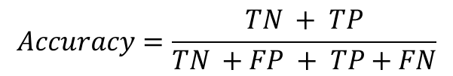
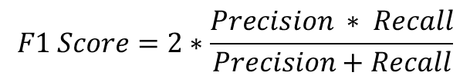
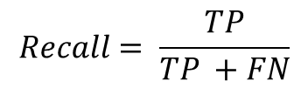
Classification Report
Precision = $\frac{TP}{TP + FP}$
$$Recall= \frac{TP}{TP +FN}$$
$$F1 Score=2∗\frac{Precision ∗ Recall}{Precision+Recall}$$
$$Accuracy=\frac{TN + TP}{TN +FP + TP+FN}$$
The overall accuracy of the model is 84.64 %.

Slide 18
References
Siuly Siuly, Yan Li, Yanchun Zhang - EEG Signal Analysis and Classification - Techniques and Applications, 2016.
Aboul Ella Hassanien, Ahmad Taher Azar, Brain-Computer Interfaces, 2015.
Patrick Cunningham Keith Lang Brian Mearns Lee Russell Stephen Sanchez, EEG Brain-Computer Interface Project, April 2007.
Mohammadshakib Moshfeghi, Aliye Tuke Bedasso, Jyoti Prasad Bartaula, Emotion Recognition from EEG Signals using Machine Learning, Bachelor Thesis Electrical Engineering, March 2013.
Raman K. Malhotra, Alon Y. Avidan, Sleep Stages and Scoring TechniqueI, Chapter 3, 2017.
Bryn Farnsworth, What is EEG and how does it work, 13th July 2021 https://imotions.com/blog/what-is-eeg/
Stages of Sleep, https://courses.lumenlearning.com/wsu-sandbox/chapter/stages-of-sleep/
A Harvard Health article, The Science of Sleep: Stages and Cycles, https://www.helpguide.org/harvard/biology-of-sleep-circadian-rhythms-sleep-stages.htm
Electroencephalography, https://en.wikipedia.org/wiki/Electroencephalography
Hafeez Ullah Amin, Wajid Mumtaz, Ahmad Rauf Subhani, Aamir Saeed Malik, Classifications of EEG Signals Based on Pattern Recognition Approach, Front. Comput. Neurosci., 21 November 2017 https://www.frontiersin.org/articles/10.3389/fncom.2017.00103/full
B Kemp, AH Zwinderman, B Tuk, HAC Kamphuisen, JJL Oberyé. Analysis of a sleep-dependent neuronal feedback loop: the slow-wave microcontinuity of the EEG. IEEE-BME 47(9):1185-1194 (2000).
Goldberger AL, Amaral LAN, Glass L, Hausdorff JM, Ivanov PCh, Mark RG, Mietus JE, Moody GB, Peng C-K, Stanley HE. (2000) PhysioBank, PhysioToolkit, and PhysioNet: Components of a New Research Resource for Complex Physiologic Signals. Circulation 101(23):e215-e220
Chambon, S., Galtier, M., Arnal, P., Wainrib, G. and Gramfort, A. (2018)A Deep Learning Architecture for Temporal Sleep Stage Classification Using Multivariate and Multimodal Time Series. IEEE Trans. on Neural Systems and Rehabilitation Engineering 26: (758-769).

Slide 19
Thank You

